Slide 1
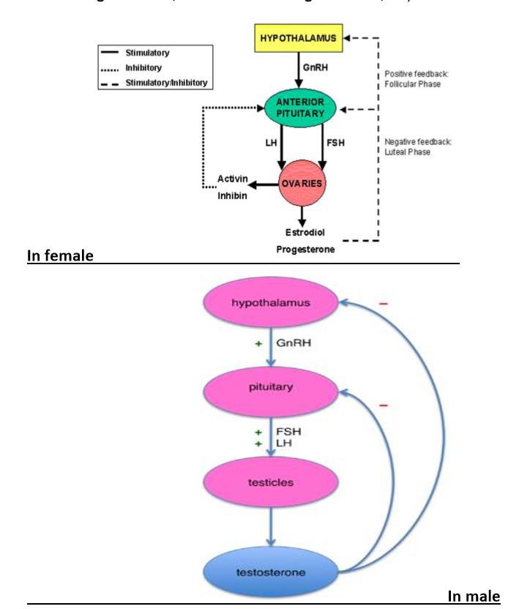
Sex Hormones

Slide 2
Sex (Gonadal) Hormones
Sex hormones (estrogens & androgens) are produced & secreted from gonads.
Both in male (androgens) & female (estrogens and progestogins)
They are necessary for conception, embryonic maturation, & development of primary & secondary characteristics at puberty.
Clinically used for contraception, replacement therapy, and several antagonist are effective in cancer

Slide 3
OVARIAN HORMONES
The ovary is the primary source of gonadal hormones in women during the childbearing years (ie, between puberty and menopause).
Mechanism of action of both estrogen and progesterone involves entry into cells & bind to specific nuclear receptors to initiate RNA synthesis. This results in specific proteins synthesis which mediate the effects of the hormone
Drugs that occupy the receptors without such effect act as antagonists, e.g. clomifene

Slide 4
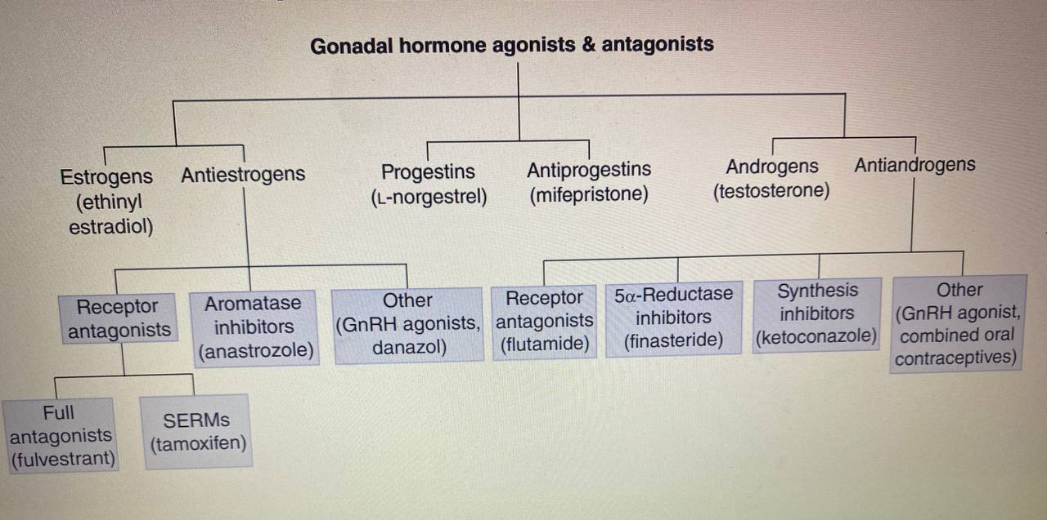

Slide 5
Estrogens
Estrogens are required for the normal sexual maturation of the female organs & the secondary sexual characteristics.
Two types of estrogens:
Naturally occurring
Estradiol (the major product of the ovary)
Estrone (after menopause in adipose t.)
Estriol (in pregnancy from the placenta)
Estrone & estriol are less potent metabolites of estradiol

Slide 6
2. Synthetic Estrogens
Ethinylestradiol : Undergoes less first pass metabolism than the natural estrogens, so are effective orally.
Pharmacokinetics Estrogens are readily absorbed through GIT, skin and mucus membrane. Estradiol is rapidly metabolized compared with ethinylestradiol .
Estrogens are fat soluble, stored in adipose tissue
They are excreted in bile and reabsorbed through entero-hepatic circulation.
Synthetic estrogens have longer duration of action and higher potency than natural estrogens.

Slide 7
Therapeutic Uses of Estrogens
1. For contraception
2. Replacement therapy
a. Postmenopausal - to relieve vasomotor symptoms like hot flushes, sleeplessness and vaginal dryness
b. Premenopausal patients e.g. primary or premature or surgical menopause

Slide 8
Adverse Effects
1. Nausea and breast tenderness
2. Headache, peripheral edema and hypertension
3. Postmenopausal uterine bleeding
4. Increased risk of thromboembolism, gall stones, breast and endometrial cancer

Slide 9
Progesterone
Progesterone is the natural progestin, is produced in response to LH in both females (secreted by corpus luteum during the 2nd half of menstrual cycle and by placenta) and in males (secreted by testes). Also by both sexes in adrenal cortex
In female it converts uterine epithelium from proliferative to secretory phase for implantation of the newly formed embryo

Slide 10
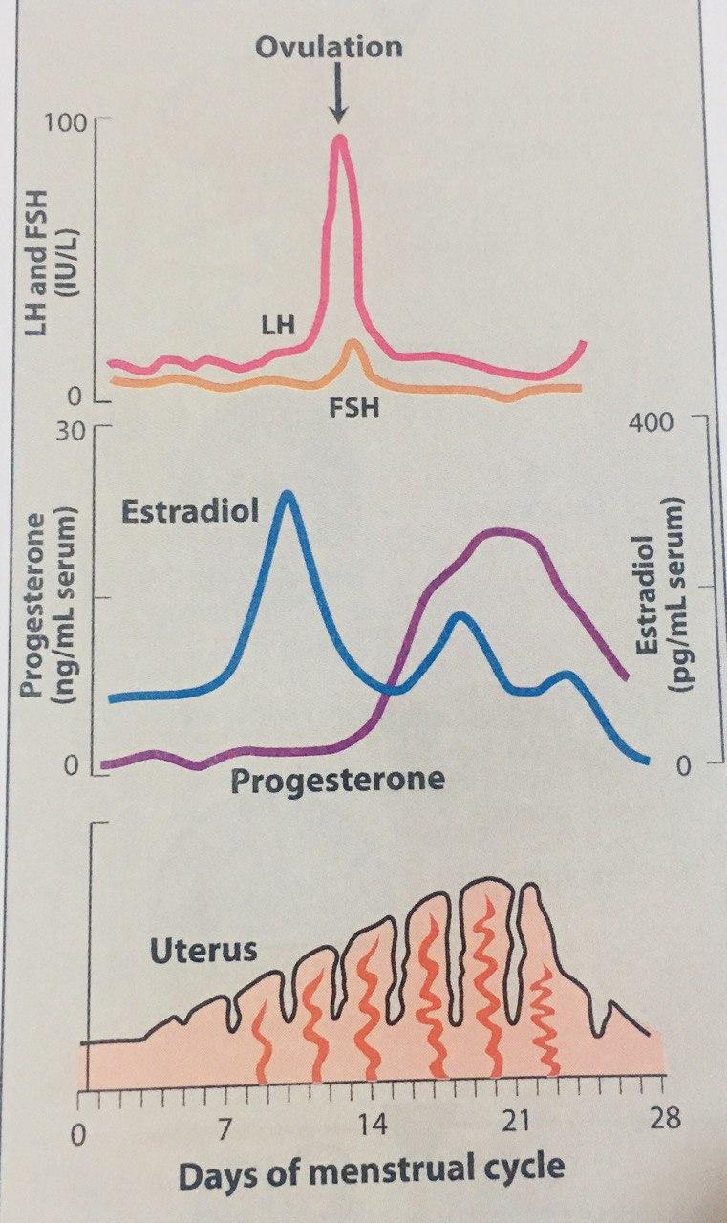
The high levels of progesterone during the luteal phase inhibit production of gonadotrophins and prevent further ovulation
If no conception,
→ no release of progesterone, which stimulates the onset of menstruation

Slide 11
Progestogins are of two types:
1. Progesterone and its derivatives: Medroxyprogesterone (Provera, Depo-provera)
2. Testosterone derivatives: (norethisterone (primolut N), norgestrel, levonorgestrel)
Older drugs (eg, Levonorgestrel and norethisterone) are more androgenic than the newer progestins (eg, norgestrel, desogestrel).

Slide 12
Pharmacokinetics
Progesterone is taken orally, well absorbed, has short half-life and completely metabolized by liver
Synthetic progestins are less rapidly metabolized
Duration of action of progestins lasts for 1-3 days while of medroxyprogesterone for 3 months

Slide 13
Clinical Uses
1. For contraception
2. Postmenopausal hormone replacement therapy
3. Dysfunctional uterine bleeding
4. Endometriosis: Depo-Provera
5. Dysmenorrhea: Depo-Provera (with tranexamic A., mefenamic A)
6. To promote and maintain pregnancy

Slide 14
Adverse Effects
Headache, depression, weight gain and changes in libido
The testosterone derivatives have androgenic activity causing hirsutism
Injectable medroxyprogesterone (Depo-provera) is associated with increased risk of osteoporosis (so duration of use should be less than 2 years)

Slide 15
Hormonal Contraceptives
Hormonal contraceptives contain either a combination of an estrogen and a progestin or a progestin alone.
Hormonal contraceptives are available in a variety of preparations, including oral pills, long-acting injections, subcutaneous implants, transdermal patches, vaginal rings, and intrauterine devices (IUDs)

Slide 16
Oral Contraceptives
1. Combined oral contraceptive pills (COCP)
2. Progestogin-only pills (POP), “Minipill”
Mechanism of action
1. The principal mechanism is inhibition of ovulation through suppression of LH surge by hypothalamus and pituitary
2. Alteration of uterine tubes, and endometrium that decrease the likelihood of fertilization and implantation.
3. Cervical mucus becomes more viscous and impedes the passage of sperms

Slide 17
Combined Oral Contraceptive Pills
Is a combination of estrogen (ethinylestradiol 20-35 microg., mestranol 50 microg.) and progestin(norethisterone 1mg, levenorgestrel 150 microg., desogestrel 150 microg.)
The pill started on first day of menstruation & continued for 21 days, followed by a period of 7 days when no pill or tonic pills are taken during which withdrawal bleeding occurs

Slide 18
Examples of Combinations:
Mercilon (ethinylestradiol 20 microg. + desogestrel 150 microg.)
Marvelon (ethinylestradiol 30 microg. + desogestrel 150 microg.)
*Reduction of breakthrough bleeding is a guide to dose adequacy
*Enzyme inducers reduce effect.
*The incidence of toxicity has fallen since the introduction of the low-dose combined oral contraceptives.

Slide 19
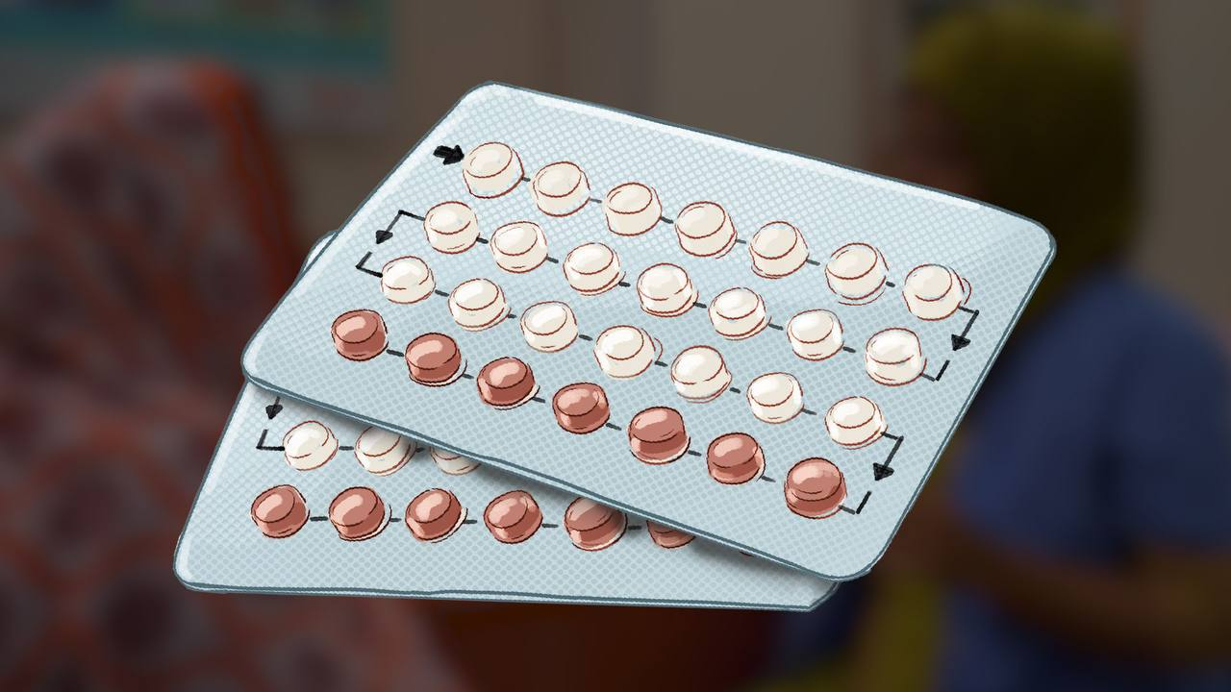

Slide 20
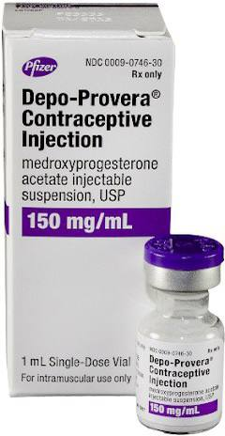

Slide 21
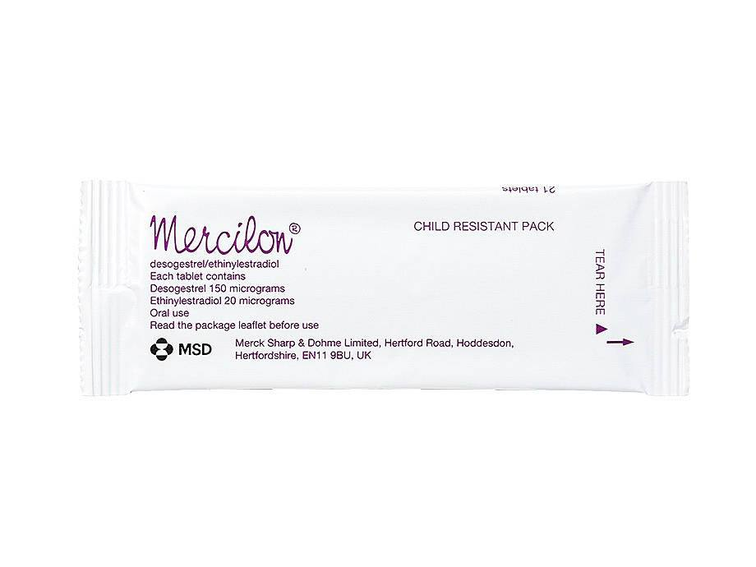

Slide 22
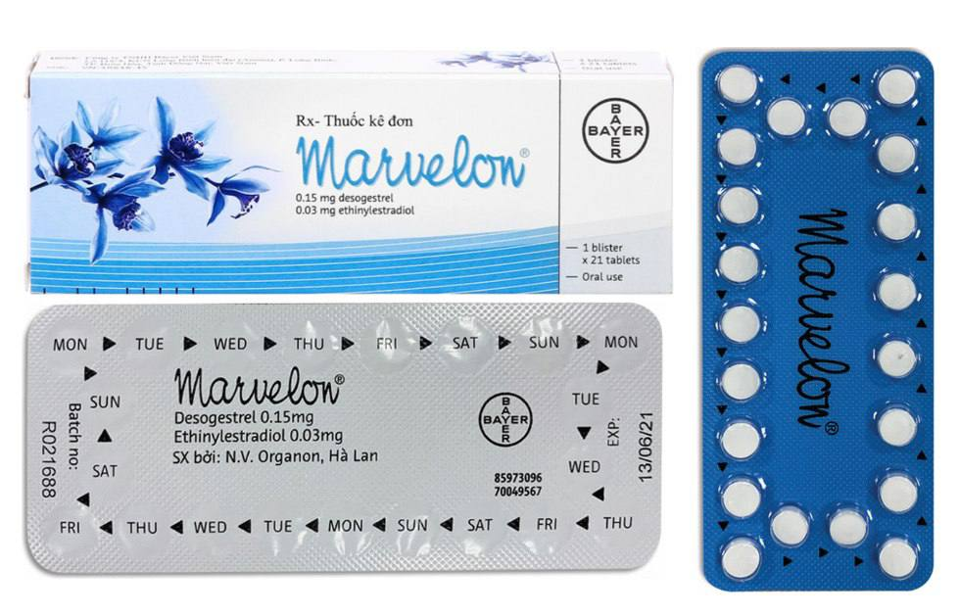

Slide 23
Other Clinical Benefits of OCP
In young women with primary hypogonadism to prevent estrogen deficiency
To treat acne, hirsutism, dysmenorrhea, and endometriosis. Medroxyprogesterone depot provides 3 months of an ovarian suppressive effect because of inhibition of pituitary production of gonadotropins
Reduce risks of ovarian cysts, ovarian and endometrial cancer, benign breast disease, and pelvic inflammatory disease as well as a lower incidence of ectopic pregnancy, iron deficiency anemia, and rheumatoid arthritis.

Slide 24
Adverse effects
Are mainly due to estrogen component
Cardiovascular & metabolic SE
Thromboembolism is a major problem, fluid retention, hypertension, increased incidence of myocardial infarction, cerebral and coronary thrombosis.
Abnormal glucose tolerance (insulin resistance), weight gain

Slide 25
Absolute contraindications
1. History of thromboembolic disease
2. Infective hepatitis or hepatoma
3. carcinoma of breast or genital tract
4. Undiagnosed vaginal bleeding
5. Migraine: Estrogen-containing hormonal contraceptives increase the risk of episodes of migraine headache.

Slide 26
Missed pill
1. If an omitted dose is remembered within 12h, it should be taken at once and the next dose at the usual time
2. If more than 12h have elapsed, it should be taken at once with the next dose at the usual time but additional barrier method of contraception should be used for 7 days

Slide 27
Progestogen Only Contraception (Minipill)
It is indicated :
1. when estrogen is contraindicated (e.g. HT, DM thromboembolism, migraine, major surg.)
2. Lactating women (Depo-provera is excreted in milk, wait 6 wk. for infants enzyme maturation)
Mechanism of action: Render cervical mucus less permeable to sperms & induce premature endometrial secretary changes so implantation does not occur. Desogestrel inhibits ovulation as effective as combined pills

Slide 28
Postcoital (emergency) contraception
Risk of pre-unprotected pregnancy after a single intercourse is 3%. This risk increase to 30% in the days around ovulation.
Progestogin-only treatment is preferred. Levonorgestrel 1500 micrograms is taken within 72 hrs of unprotected sexual intercourse or high dose of combined ethinylestradiol plus levonorgestril (less tolerated)
The mechanisms of action are not well understood. When administered before the LH surge, they inhibit ovulation. They also affect cervical mucus, tubal function, and the endometrial lining.

Slide 29
Anti-estrogens and estrogen modulators
They act on estrogen receptor but have different effects as agonists or antagonists according to tissue type
This includes: clomifine, tamoxifen, raloxifene

Slide 30
1. Clomifene (Clomid)
Weak partial estrogen agonist (antagonism), interferes with negative feedback of estrogens, leading to stimulation of ovulation
Used in infertility associated with anovulatory cycles (Clomid 50mg on day 2-6)
SE: headache, nausea, hot flushes, visual disturbances and ovarian enlargement
Multiple ovulations & multiple pregnancies.

Slide 31
2. Tamoxifen
Competes with estrogen for binding to estrogen receptor in breast tissue, so used in palliative treatment of metastatic breast cancer, postmastectomy & for prophylaxis in high risk patient (family history).
Side effects: hot flushes and nausea, menstrual irregularity and vaginal bleeding, may cause endometrial hyperplasia and malignancies due to its estrogenic activity in endometrium

Slide 32
Raloxifene
In addition to tamoxifen like effect on breast, raloxifene acts as an estrogen agonist in bone, leading to increased bone density & decreased vertebral fractures.
Raloxifene does not stimulate endometrial growth & does not predispose to endometrial cancer.

Slide 33
Other progestogin derivatives
Danazol (Danol)
is a weak partial agonist of progestin, androgen, and glucocorticoid receptors. The drug is used in the treatment of endometriosis and fibrocystic disease of the breast.
Mechanism of action
Selective inhibitor of pituitary gonadotrophin secretion (FSH & LH)→reduces ovarian function, which leads to atrophic changes in endometrium both uterine and ectopic endometriosis.
In males it reduces spermatogenesis.

Slide 34
Uses of Danazol
1. Endometriosis
2. Fibrocystic breast disease
3. Gynecomastia
4. Precocious puberty
5. Menorrhagia
Side effects
Virilization, acne, hirsutism

Slide 35
Antiprogestins
Mifepristone is an orally active antagonist of progesterone. Its major use is as an abortifacient in early pregnancy (up to 49 days after the last menstrual period).
The combination of mifepristone and the prostaglandin E analog misoprostol achieves a complete abortion in over 95% of early pregnancies. The most common complication is failure to induce a complete abortion.

Slide 36
Infertility Treatment
(women & men)
Hypothalamic hormone: Gonadorelin
Anterior pituitary hormones: FSH, human chorionic gonadotrophin (hCG)
Anti-estrogens: Clomifene
Cabergoline & bromocriptine (dopamine agonist) for hyperprolactinemia

Slide 37
Androgens
Group of steroids that have anabolic &/or musculinizing effects in both males and females.
The most important androgen is testosterone; synthesized by leydig cells in testes.
Anabolic steroids (e.g. nandrolone)

Slide 38
Androgens are required for:
1. Normal maturation in male
2. Sperm production
3. Increased synthesis of muscle proteins and hemoglobin
4. Promote bone growth & hasten closure of epiphyses (short stature in precocious puberty)

Slide 39
Mechanism of Action
Testosterone binds to specific nuclear receptor in target cells. It is active in liver and muscle
But in other tissues like prostate, seminal vesicle, epididymis and skin; it should be converted by 5α-reductase to dihydrotestosterone (DHT; the active metabolite) which binds to the receptor.

Slide 40
Pharmacokinetics
Testosterone is ineffective orally (because of the first pass metabolism), so administered i.m., transdermal patch, topical gel, and buccal tablets are also available.
Testosterone derivatives (oxandrolone) are given orally.
Example of anabolic steroids: Nandrolone (taken by deep i.m. injection every 3 weeks)

Slide 41
Therapeutic Uses
1. Androgenic effect-for primary and secondary hypogonadism & delayed puberty
2. Anabolic effect: anabolic steroids (e.g. nandrolone) are used in:
a. Senile osteoporosis (prevents calcium and nitrogen loss in urine)
b. Chronic wasting associated with HIV infection or cancer
c. Severe burns, recovery from surgery or chronic debilitating disease

Slide 42
e. Some patients with aplastic anemia
3. Endometriosis- Danazol
4. Unapproved use by athletes and body builders to increase body mass & muscle strength
5. Testosterone effect on erectile dysfunction is less clear & sildenafil (viagra) & tadalafil (cialis) are more appropriate

Slide 43
Adverse effects:
1. In female: Musculinization, acne, hirsutism, deepening of voice, menstrual irregularities
2. In male: increased lipido, priapism, baldness, gynecomastia & stimulates growth of prostate
3. In children: Abnormal sexual maturation and growth disturbances resulting from premature closure of epiphysis
In men, large doses of anabolic steroids are associated with liver impairment, including cholestasis and elevation of liver enzyme

Slide 44
Antiandrogens
Cyproterone ( a derivative of progesterone)
It competes with testosterone for receptors in target organs, so reduces spermatogenesis, abnormal sperms occur during treatment. It also competes with testosterone in CNS causing impotence

Slide 45
Uses:
To reduce male hypersexuality 50 mg twice/d
Prostatic cancer
Severe female hirsutism and severe acne
* Diane 35 is a formulation of cyproterone 2mg + ethinylestradiol 35 microg.)

Slide 46
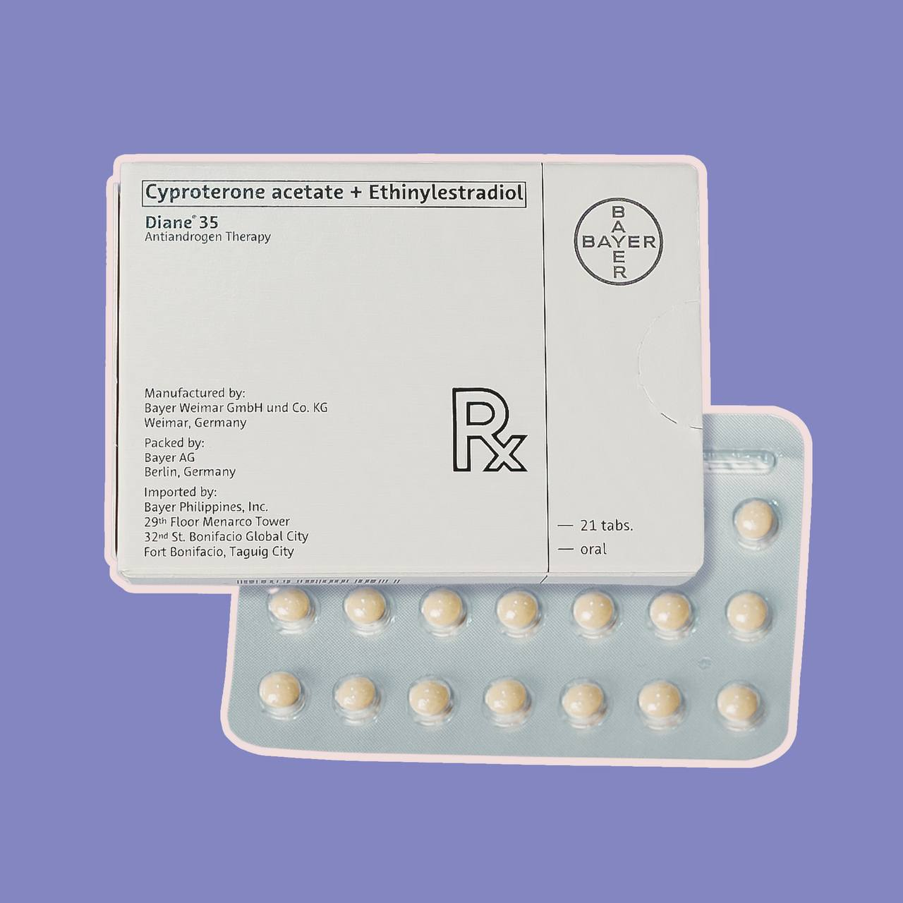

Slide 47
Flutamide is a competitive antagonists of androgen receptors. It is used to decrease the action of endogenous androgens in patients with prostate carcinoma.
Spironolactone, a drug used principally as a potassium-sparing diuretic, also inhibits androgen receptors and is used in the treatment of hirsutism in women.
Ketoconazole, an antifungal drug, inhibits gonadal and adrenal steroid synthesis. The drug has been used to suppress adrenal steroid synthesis in patients with steroid-responsive metastatic prostate cancer.

Slide 48
5-Reductase Inhibitors:
Testosterone is converted to dihydrotestosterone (DHT) by the enzyme 5α-reductase. Some tissues, most notably prostate cells and hair follicles, depend on DHT rather than testosterone for androgenic stimulation.
This enzyme is inhibited by finasteride, a drug used to treat benign prostatic hyperplasia and, at a lower dose, to prevent hair loss in men. Because the drug does not interfere with the action of testosterone, it is less likely than other antiandrogens to cause impotence, infertility, and loss of libido.
Dutasteride is a newer 5α-reductase inhibitor with a much longer half-life than that of finasteride.

Slide 49
Write briefly on
Mechanism of contraceptive pills action
Absolute contraindications of oral contraception
Indication of progestogin-only pills
Clinical uses of danazol

Slide 50
MCQ
Mechanism of action of the combined oral contraceptive tablet include all the following except:
a. Inhibition of ovulation
b. Direct spermicidal effect
c. Endometrial changes
d. Increase viscosity of cervical mucous
e. Inhibition of ovum implantation
b

Slide 51
MCQ
Danazol is used in all the following conditions EXCEPT:
Endometriosis
Gynecomastia
Precocious puberty
Menorrhagia
Hirsutism
E

Slide 52
MCQ
The following are absolute contraindications to the use of combined oral contraceptive pills EXCEPT:
Smoking
Breast cancer
Thromboembolism
Undiagnosed vaginal bleeding
Hepatoma
A

Slide 53
MCQ
The “minipill” containing only a progestin, oral contraceptive, was developed because progestin alone:
a. Results in less depression and cholestatic jaundice
b. Is a more effective than the combined one
c. Results in a more regular menstrual cycle
d. Is thought to be less likely to induce endometriosis
e. Is thought to be less likely to induce cardiovascular disorders
E

Slide 54
MCQ
The following drugs are used in the treatment of infertility except:
Follicular stimulating hormone (FSH)
Bromocriptine
Clomifene
Chorionic gonadotrophin
Progesterone
E

Slide 55
MCQ
A 21 year old woman seeks postcoital contraception after 12 days of intercourse. Which of the following preparations will be effective for this purpose?
(A) Clomiphene
(B) Levonorgestrel
(C) Finasteride
(D) Mifepristone
(E) Danazol
D

Slide 56
MCQ
A 21-year-old woman desires a combined oral contraceptive for pregnancy protection. Which of the following patient factors would lead a health professional to recommend an alternative form of contraception?
Evidence of hirsutism
History of GERD and is currently on omeprazole
History of pelvic inflammatory disease
History of migraine headache
(E) She plans to use this contraceptive for about 1 year and will then attempt to become pregnant
D

Slide 57
MCQ
A 50-year-old woman with a positive mammogram undergoes lumpectomy and a small carcinoma is removed. Biochemical analysis of the cancer reveals the presence of estrogen and progesterone receptors. After this procedure, she will probably receive which of the following drugs?
Danazol
Flutamide
Levonorgestrel
Mifepristone
Tamoxifen
E

Slide 58
MCQ
A 21 year old woman complains of abdominal pain at the time of menstruation. Careful evaluation indicates endometriosis. Which of the following is the most appropriate therapy for this patient?
Flutamide, orally
Medroxyprogesterone by IM injection
Norgestrel as an IUD
Oxandrolone by intramuscular injection
Raloxifene orally
B

Slide 59
MCQ
Finasteride has efficacy in the prevention of male-pattern baldness by virtue of its ability to do which of the following?
Competitively antagonize androgen receptors
Decrease the release of gonadotropins
Increase the serum concentration of sex hormone-binding globulin
Inhibit the synthesis of testosterone
Reduce the production of dihydrotestosterone
E

